Slide 1
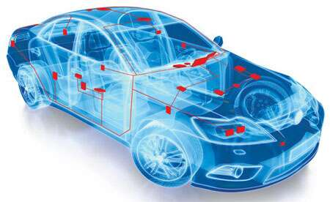
CAN PROTOCOL:
FEATURES, MESSAGING & ERROR HANDLING
2nd Nov 2022
Ashfin.R

Slide 2


Presentation Overview
Brief Introduction
Features of CAN
The CAN Bus
Message Frames
Error Handling
CAN Messaging
Conclusion
Differential Wiring
Bit Stuffing
Data Frame
Remote Frame
Error Frame
Overload Frame
Error Types
Error Flags
Error Counters

Slide 3

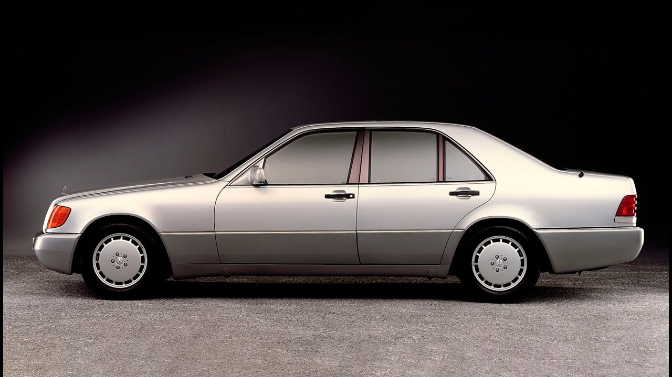

Brief Introduction to CAN
CAN stands for Controller Area Network
CAN Protocol was (developed and) released by BOSCH in 1986
The first CAN controller chips were introduced by Intel in 1987
First vehicle to use a CAN based wiring system was the Mercedes-Benz W140 (1991)

Slide 4
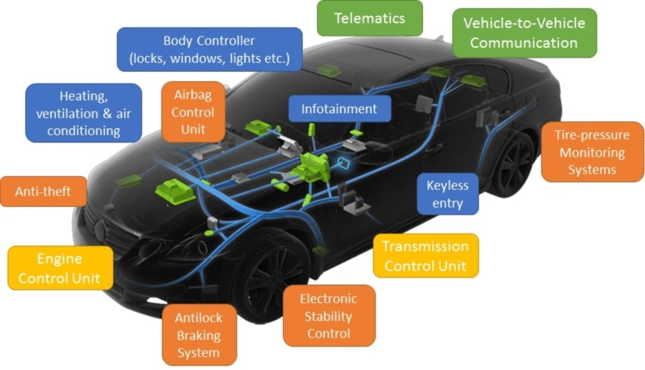
Brief Introduction to CAN
CAN Protocol describes a network of connection between multiple ECUs

Slide 5
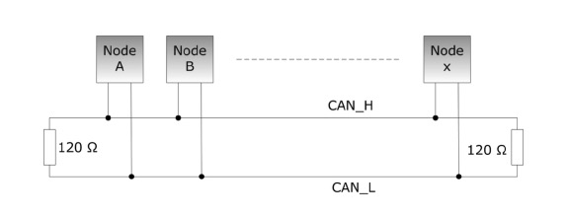
Features of CAN
Follows 2-Wire Differential Bus Topology
Able to handle electromagnetic noisy environment
Serial & Multicast
Max data rate of 1 Mbit/s (up to 40 m)
Max data length of 8 bytes
Robust Error-Handling
Supports Hot-Plugging
120 Ohm termination resistance & ~60 Ohm bus resistance

Slide 6
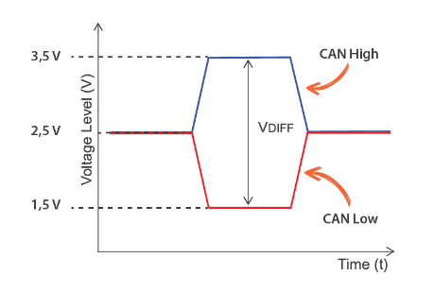
The CAN Bus
2 signals of equal magnitude and opposite polarity
CAN High
CAN Low

Slide 7
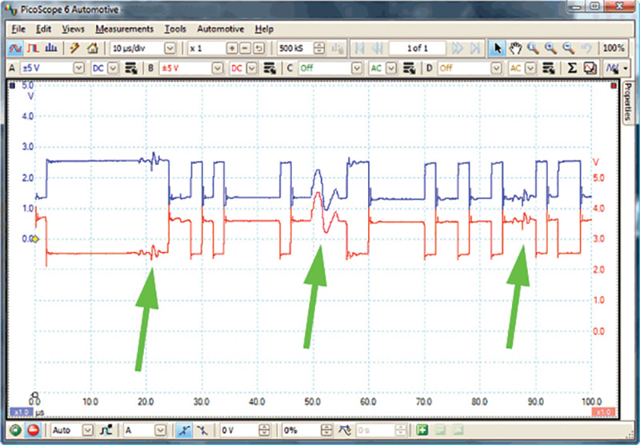
The CAN Bus
Differential signal eliminates
unwanted noise
Differential Voltage
Vd = Can High – Can Low

Slide 8
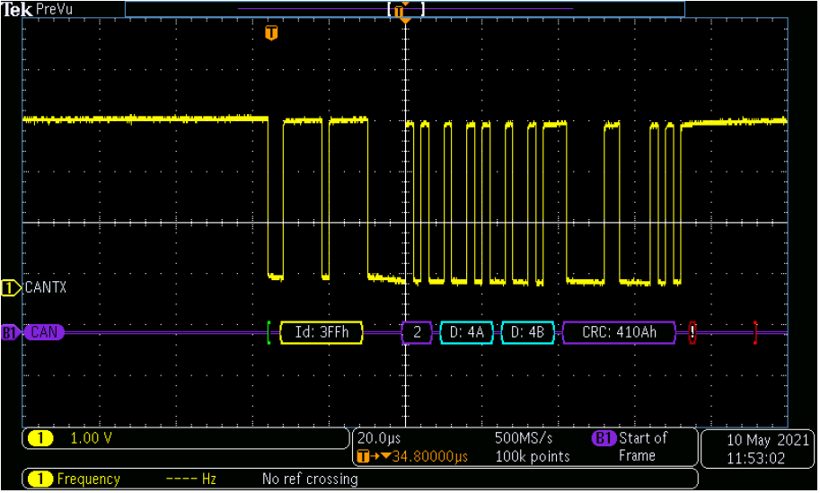
The CAN Bus
Can Bus acts as “wired-and”
Recessive state = Logic 1
Dominant state = Logic 0

Slide 9

CAN MESSAGE FRAMES

Slide 10
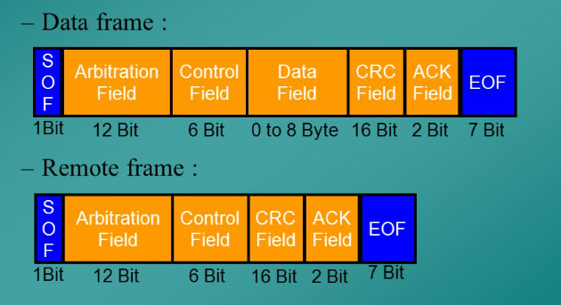
CAN Frames/Messages
4 Types of Frames:
Data Frame
Remote Frame
Error Frame
Overload Frame

Slide 11
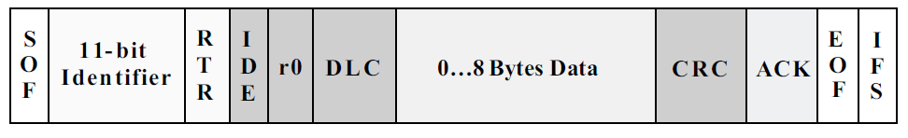
Data Frame
SOF (Start Of Frame): - 1 dominant bit (Logic 0)
- Synchronizes all nodes after bus idle
Arbitration Field
Identifier: - 11 bit for Standard CAN Frame
- 29 bit for Extended CAN Frame
- Used for Message arbitration
Eg. for 11 bit identifier: 111 1111 0111 (0x7F7)
Note: -CAN Frames are “content addressed” and not “message addressed”

Slide 12

Data Frame – Msg. Arbitration
Any node can start transmission if the bus is idle (>= 11 consecutive recessive bits)
Conflict arises when 2 or more nodes try to start transmission at the same time
Arbitration Process:
all transmitting nodes monitor the CAN Bus
if a transmitting node detects a dominant bit when it is sending a recessive bit,
it stops transmission immediately and acts as a receiving node
This arbitration process is done for the entire identifier bit field (11 bits)
After the process, only one transmitter will remain on the bus
Other nodes try to re-transmit the messages once the bus is idle again
Non-destructive and delay-free arbitration process

Slide 13
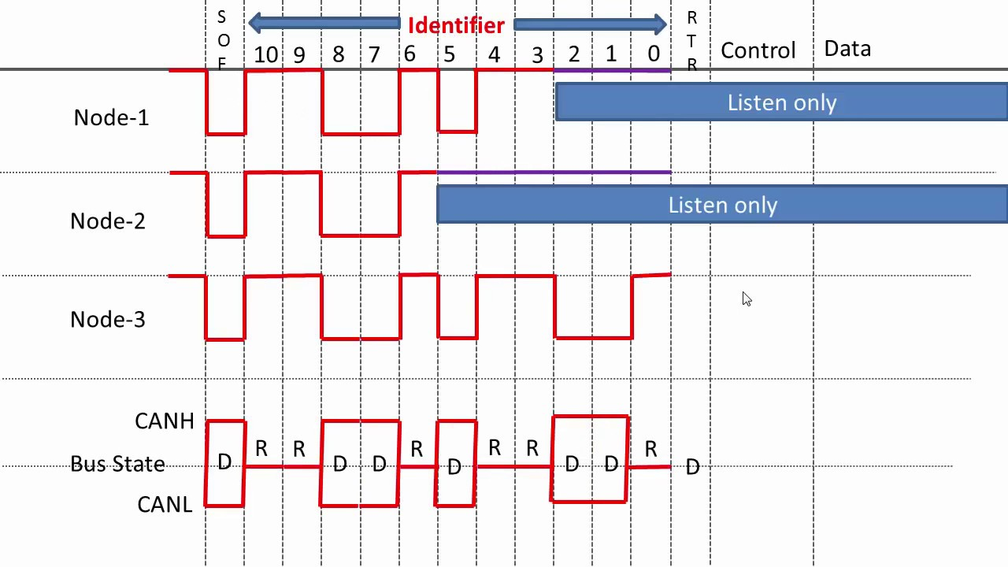
Data Frame – Msg. Arbitration
0x65F
0x67F
0x659

Slide 14
Data Frame
RTR (Remote Transmission Request): - 1 bit
- To distinguish Data & Remote Frames
- Dominant in Data Frames (hence more priority)
- Recessive in Remote Frame
Control Fields:
IDE (Identifier Extension) : - 1 bit
- To distinguish if it’s 11 bit standard identifier or 29 bit extended identifier
- Dominant → 11 bit std identifier
- Recessive → 29 bit extended identifier

Slide 15
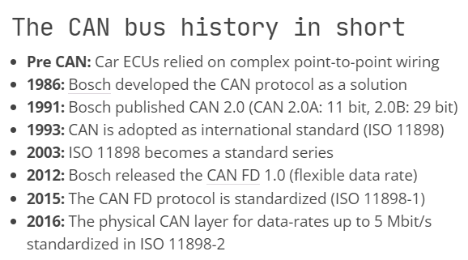

Standard vs Extended CAN Frames
Only difference in number of Identifier Bits
Standard CAN frame is described in CAN Protocol 2.0A and 2.0B
Extended CAN frame is described only in CAN Protocol 2.0B
CAN controllers which support extended CAN frames can also support standard CAN (backward compatible)

Slide 16
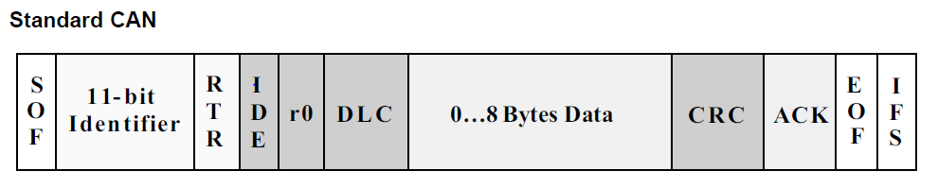
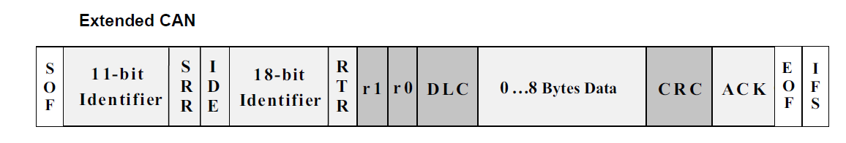
Data Frame
SRR (Subsequent Remote Request): - Used in CAN2.0B for backward compatibility
- 1 bit
- Always recessive
- So that 11 bit Std. frame always wins the arbitration against 29 bit ext. frame with the same 11 bit msb

Slide 17
Data Frame
r0, r1 bits : reserved bits for future use
DLC (Data length Count): - 4 bits
- Number of bytes of data to be transmitted
Data field: - Up to 64 bit/8 Byte Data
CRC field: - 16 bits (15 bit CRC + 1 bit delimiter)
- Delimiter bit buys breathing time for CRC calculation at receiving node
- Has checksum of the data for error-detection (discussed later)

Slide 18
Data Frame
ACK field (Acknowledgement): - 1 Bit (+1 recessive bit delimiter)
- Always recessive in the original message send by the transmitting node
- if any receiving node receives the frame without any errors, it sends a dominant bit during the acknowledgement slot and makes the bus dominant, thus sending acknowledgment to the transmitter.
- At-least 1 receiving node should do acknowledgment to avoid
ACK error (discussed later)

Slide 19
Data Frame
EOF (End of Frame): - 7 consecutive recessive Bits
- Marks the end of a frame
IFS (Inter-Frame Space): - 3 consecutive recessive bits
- Gives sufficient breathing time for CAN controllers to move the received frame to the message buffer area

Slide 20
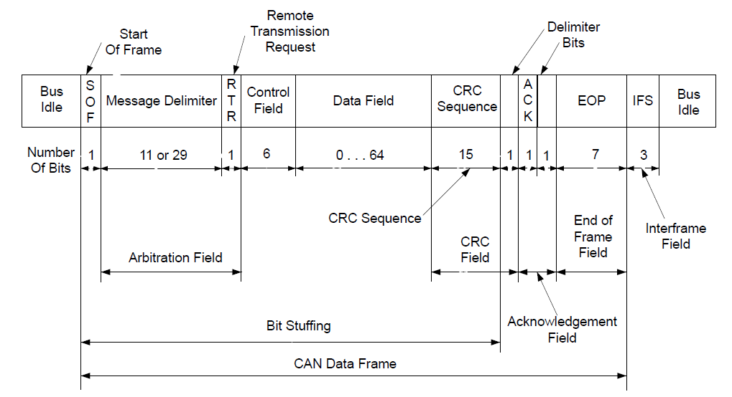
Data Frame - Summary

Slide 21
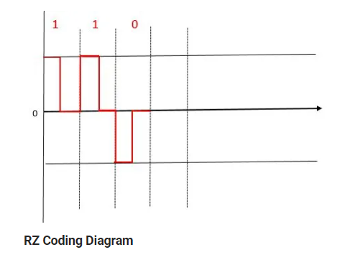
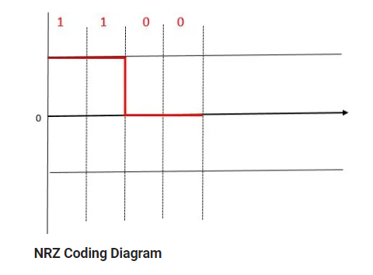
The CAN Bus – Synchronization
No clock signal but bit rate is specified for all nodes
CAN Bus follows NRZ (Non-Return to Zero) transmission, hence no rest state between bits

Slide 22
The CAN Bus – Synchronization
CAN transceivers synchronize during the change in polarity:
First hard Synchronization happens during the falling edge of SOF Bit, ie First recessive to dominant after Bus idle
After which re-Synchronization happens during every falling edge

Slide 23
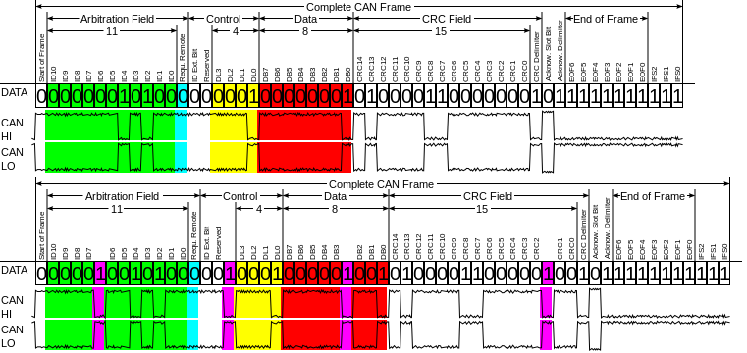
The CAN Bus – Bit Stuffing
Bit Stuffing: When a node transmits more than 5 bits of same polarity, 1 bit of opposite polarity is added/stuffed for synchronization purpose.
The receiving node removes the stuffed bit
Six consecutive bits of same polarity (111111 or 000000) violates CAN frame formatting and results in an error (discussed later)

Slide 24

CAN Frames Summary
Data Frame: - Most commonly used
- To transmit & receive data
Remote Frame: - Same structure as a Data Frame except without the data field
- Used to request data from another node
Error Frame: - Rarely used
- Sent during error condition (discussed later)
Overload Frame: - Very Rarely/not used
- Same structure as an Error Frame
- Sent by a node when it becomes too busy
- Used to provide an extra delay

Slide 25

CAN: Error Check & Fault Confinement

Slide 26

CAN: Error Check & Fault Confinement
5 methods of error checking: 3 at msg. level and 2 at bit level
Message level:
a. CRC Error: - 15 bit CRC is transmitted along with data
- The receiving node also calculates the CRC
- Error if the sent & received CRC doesn’t match
b. ACK Error: - if the bus is not dominant during ACK slot
c. Form Check: - Some bits in the message should be always recessive
- They are SOF, EOF,ACK delimiter, and CRC delimiter bits
- Error if dominant bit is detected
Bit level:
a. Bit error: - Transmitting node monitors the bus after writing each bit to the bus
- Error if the bit written & read doesn’t match
- Exceptions: Arbitration bits & ACK bit
b. Bit-stuff error: - Error if bit stuffing rule is violated

Slide 27
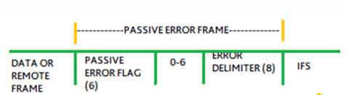
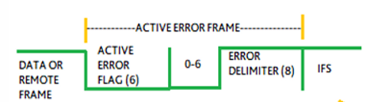
CAN: Error Check & Fault Confinement
Any of the above error will result in an error frame/error flag to be sent by either the transmitting/receiving node
An error frame is a special frame which violates the bit stuffing rule
Hence forces all other nodes to send 1 more error frame (if not sent already)
Can be either active or passive based on the error counter
Active error flag → 6 to 12 dominant bits + 8 recessive bits
Passive error flag → 6 to 12 recessive bits + 8 recessive bits

Slide 28
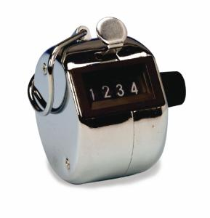
CAN: Error Check & Fault Confinement
2 Error counter are present for each node:
Receive Error Counter (REC): Incremented when the receiver of a node detects an error
Transmit Error Counter (TEC): Incremented when the transmitter of a node detects an error
Complex rules for increment/decrement of error counters, in brief:
Transmit error give 8 error points, ie increments TEC by +8
Receive error gives 1 error point, ie increments REC by 1
REC is decremented by 1 count for every correctly received message

Slide 29



CAN: Error Check & Fault Confinement
Each node(CAN controller) will be any of the 3 states as below:
Error Active: - when TEC (or REC) < 128
- Sends active error flags
- Active error flags destroys the bus traffic
- other nodes discard the current message
- Data frame is transmitted again after re-arbitration
2. Error Passive: - when TEC (or REC) > 127 (16 attempts)
- Sends passive error flags
- Passive error flags does not destroy the bus traffic nor disturb other nodes
- However the TEC count keeps on increasing
3. Bus-Off : - when TEC > 255 (32 attempts)
- No frame is transmitted
- Node disconnects itself from the Bus
- REC for all other nodes will be below passive level of 127 (255/8 ~ 32)
- Node re-initializes after 128 occurrences of bus idle
(11 consecutive recessive bits - 1 bit ACK Delimiter + 7 End-Of-Frame + 3 IFS)

Slide 30

CAN MESSAGING FLOW

Slide 31
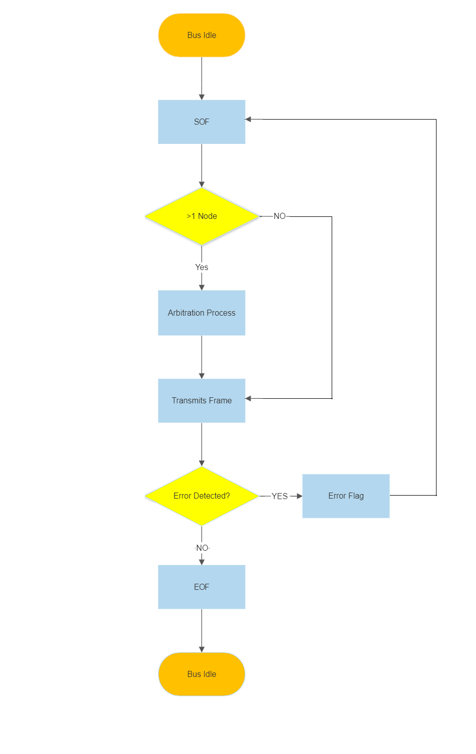

Slide 32
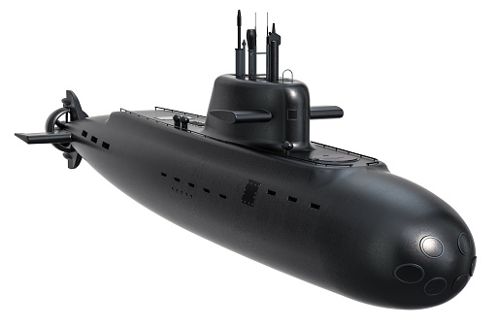
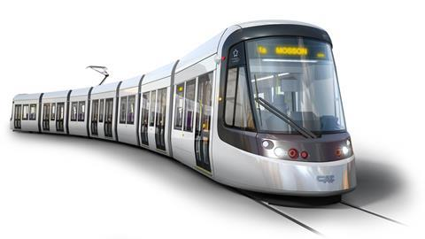
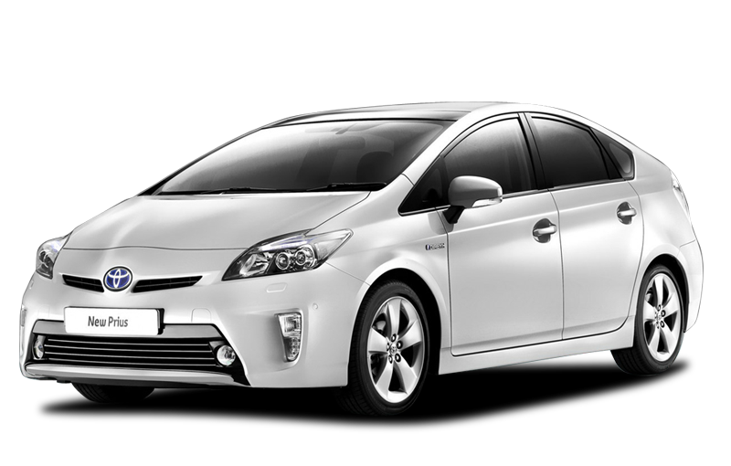
Conclusion
Ideal for applications with:
Short message length
Frequent messaging
High reliability & error handling
Noisy environment
Same data required by multiple units
Applications found in automobiles, trains, airplanes, construction, mining & marine vehicles

Slide 33
References
BOSCH. CAN Specification. Version 2.0. 1991, Robert Bosch GmbH
Texas Instruments Application Report SLOA101B - Introduction to the Controller Area Network (CAN)
https://www.eecs.umich.edu/courses/eecs461/doc/CAN_notes.pdf
https://www.influxbigdata.in/can-error-basics
https://www.kvaser.com/can-protocol-tutorial/
https://www.influxbigdata.in/can-error-basics
https://en.wikipedia.org/wiki/CAN_bus

Slide 34
Q/A
Q1. Max Speed of CAN frames per second?
Assuming worst case of extended CAN with bit stuffing, total data frame size is 131 (1+32+6+8x8+16+2+7+3) (+20 bit stuffs on worst case), 151 bits, and max bit rate of 1MBit/s, then total frames per second is 1000000/151 = 6622 frames/s (ie 0.151 ms/frame)
Q2. What happens if 2 nodes use the same CAN ID?
Assuming both Nodes are trying to send the frames at the same time:
Case 1: Both has same data, then CAN Bus sees it as 1 frame
Case 2: the 2 frames have different data, results in CRC error

Slide 35
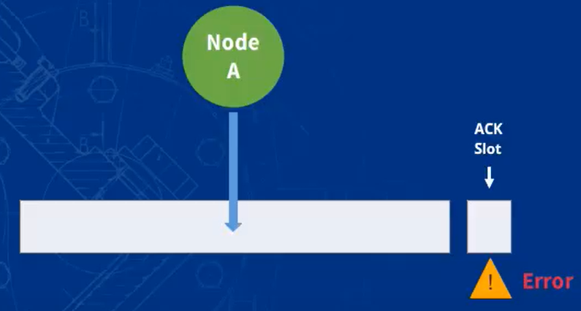
Q/A
Q3. Bus behavior with 1 CAN?
No Message arbitration
Sends Data Frame but no other node for ACK bit
Transmitter notes ACK error & sends active error frame
increments TEC by 8
This repeats 16 times & then goes to error passive mode
ACK error will not increment TEC in error passive mode (special rule)
Hence stays in error passive mode & will not reach Bus-off state
The node continues to send data frames & passive (ACK) error flags forever

Slide 36
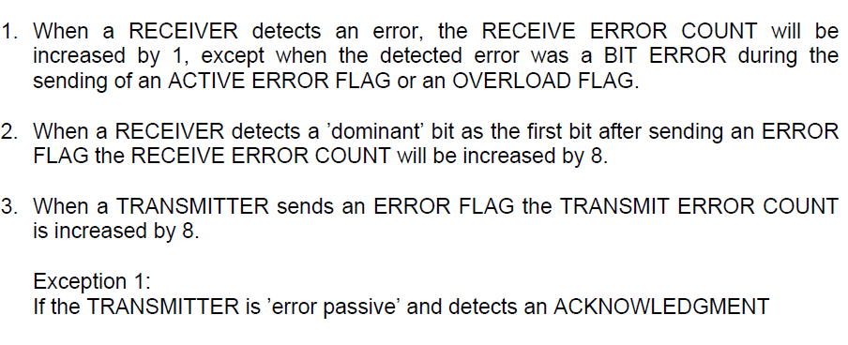
Appendix I: Rules for REC & TEC
Ref: BOSCH. CAN Specification. Version 2.0. 1991, Robert Bosch GmbH

Slide 37
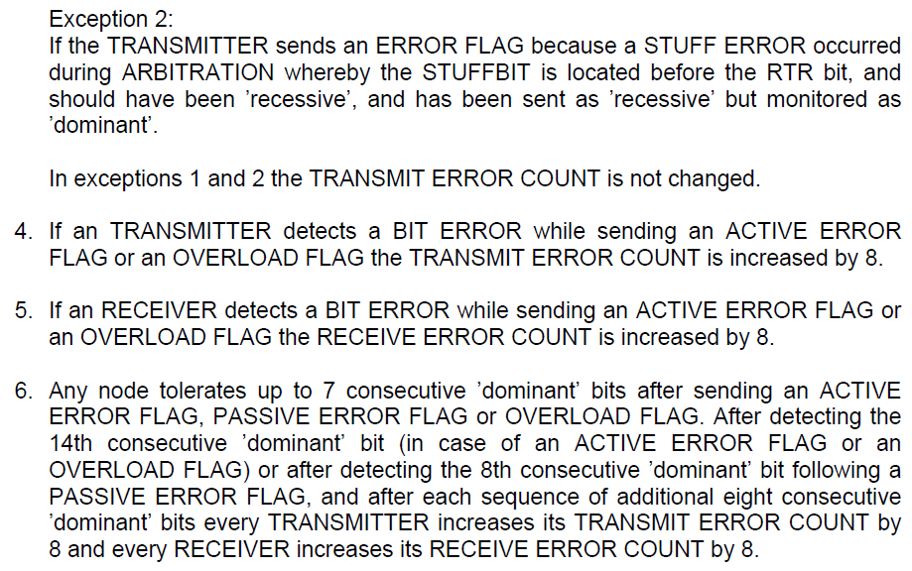
Appendix: Rules for REC & TEC

Slide 38
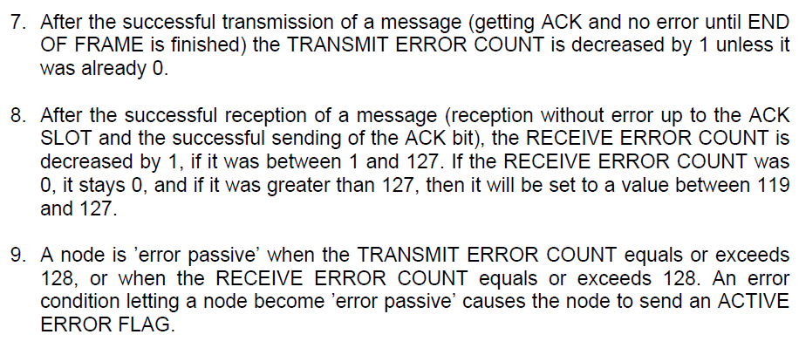
Appendix: Rules for REC & TEC

Slide 39
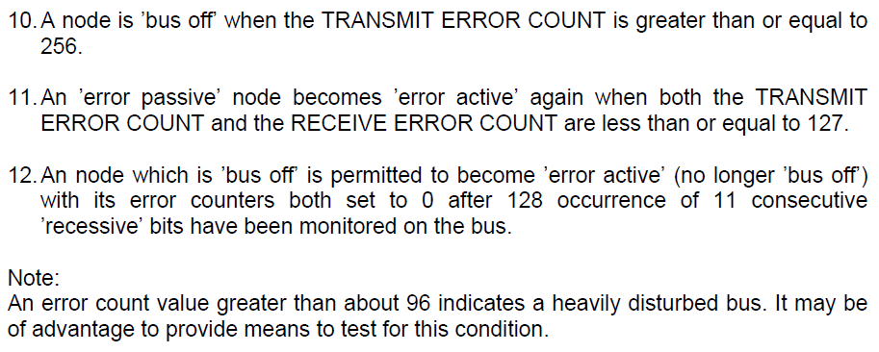
Appendix: Rules for REC & TEC

Slide 40
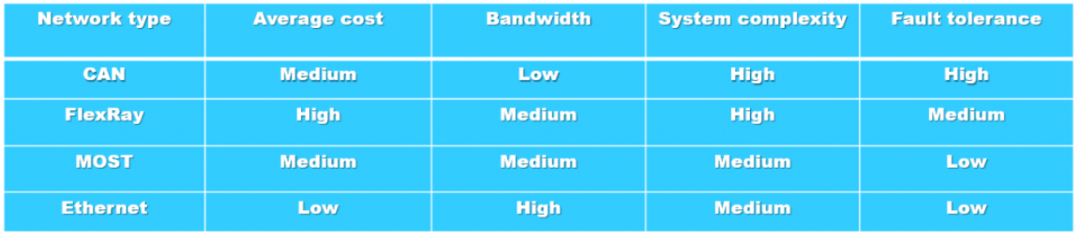
Appendix II: CAN Bus Alternatives
*MOST – Media Oriented System Transport Bus
More Info: https://www.navixy.com/docs/academy/can-bus/can-and-alternatives/

